Slide 1

JavaScript Chapter 05: Loops

Slide 2
Introduction
We are starting to get a good basic grasp of JavaScript. This chapter will focus on a very important control flow concept: loops. Loops execute a code block a certain number of times. We can use loops to do many things, such as repeating operations a number of times and iterating over data sets, arrays, and objects. Whenever you feel the need to copy a little piece of code and place it right underneath where you copied it from, you should probably be using a loop instead.
We will first discuss the basics of loops, then continue to discuss nesting loops, which is basically using loops inside loops. Also, we will explain looping over two complex constructs we have seen, arrays and objects. And finally, we will introduce two keywords related to loops, break and continue, to control the flow of the loop even more.
These are the different loops we will be discussing in this chapter:
while loop
do while loop
for loop
for in
for of loop

Slide 3
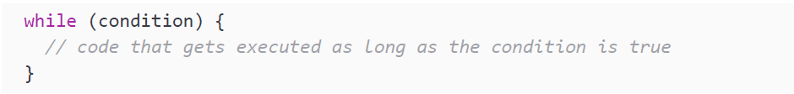
while loops
The first loop we will discuss is the while loop. A while loop executes a certain block of code as long as an expression evaluates to true. The snippet below demonstrates the syntax of the while loop:
The while loop will only be executed as long as the condition is true, so if the condition is false to begin with, the code inside will be skipped.

Slide 4
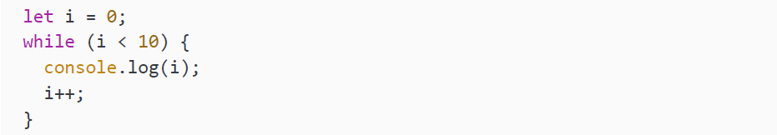
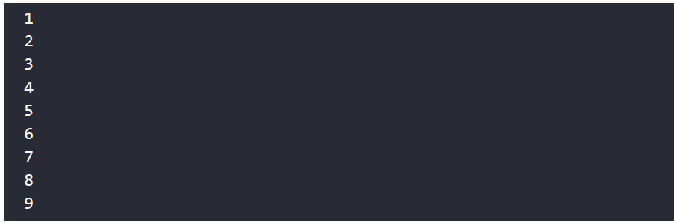
while loops
Here is a very simple example of a while loop printing the numbers 0 to 10 (excluding 10) to the console:
The output will be as follows:

Slide 5
while loops
These are the steps happening here:
Create a variable, i, and set its value to zero
Start the while loop and check the condition that the value of i is smaller than 10
Since the condition is true, the code logs i and increases i by 1
The condition gets evaluated again; 1 is still smaller than 10
Since the condition is true, the code logs i and increases i by 1
The logging and increasing continues until i becomes 10
10 is not smaller than 10, so the loop ends

Slide 6
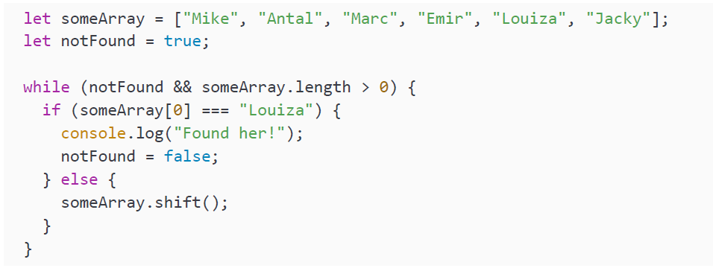
while loops
We can have a while loop that looks for a value in an array, like this:

Slide 7
while loops
It checks whether the first value of the array is a certain value, and when it is not, it deletes that value from the array using the shift method. Remember this method? It removes the first element of the array. So, by the next iteration, the first value has changed and is checked again. If it stumbles upon the value, it will log this to the console and change the Boolean notFound to false, because it has found it. That was the last iteration and the loop is done. It will output:
Why do you think the && someArray.length > 0 is added in the while condition? If we were to leave it out, and the value we were looking for was not in the array, we would get stuck in an infinite loop. This is why we make sure that we also end things if our value is not present, so our code can continue.

Slide 8
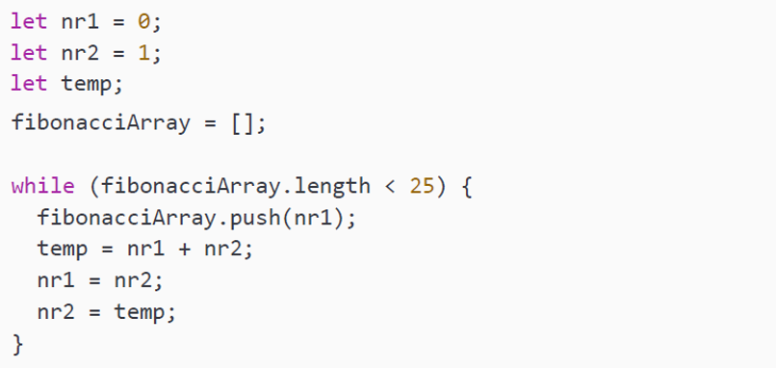
while loops
But we can also do more sophisticated things very easily with loops. Let's see how easy it is to fill an array with the Fibonacci sequence using a loop:

Slide 9
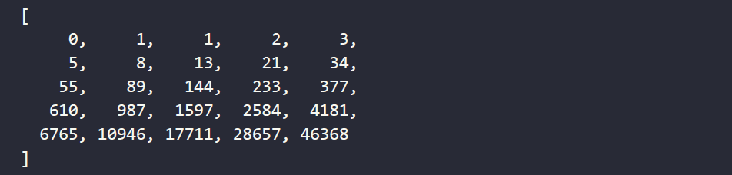
while loops
In the Fibonacci sequence, each value is the sum of the two previous values, starting with the values 0 and 1. We can do this in a while loop as stated above. We create two numbers and they change every iteration. We have limited our number of iterations to the length of the fibonacciArray, because we don't want an infinite loop. In this case the loop will be done as soon as the length of the array is no longer smaller than 25.
We need a temporary variable that stores the next value for nr2. And every iteration we push the value of the first number to the array. If we log the array, you can see the numbers getting rather high very quickly. Imagine having to generate these values one by one in your code!

Slide 10
Practice exercise 5.1
In this exercise we will create a number guessing game that takes user input and replies based on how accurate the user's guess was.
Create a variable to be used as the max value for the number guessing game.
Generate a random number for the solution using Math.random() and Math.floor(). You will also need to add 1 so that the value is returned as 1-[whatever the set max value is]. You can log this value to the console for development to see the value as you create the game, then when the game is complete you can comment out this console output.
Create a variable that will be used for tracking whether the answer is correct or not and set it to a default Boolean value of false. We can update it to be true if the user guess is a match.
Use a while loop to iterate a prompt that asks the user to enter a number between 1 and 5, and convert the response into a number in order to match the data type of the random number.
Inside the while loop, check using a condition to see if the prompt value is equal to the solution number. Apply logic such that if the number is correct, you set the status to true and break out of the loop. Provide the player with some feedback as to whether the guess was high or low, and initiate another prompt until the user guesses correctly. In this way we use the loop to keep asking until the solution is correct, and at that point we can stop the iteration of the block of code.

Slide 11
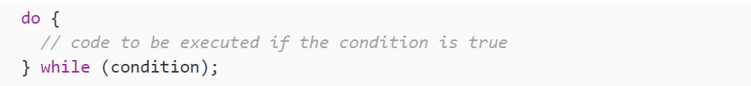
do while loops
In some cases, you really need the code block to be executed at least once. For example, if you need valid user input, you need to ask at least once. The same goes for trying to connect with a database or some other external source: you will have to do so at least once in order for it to be successful. And you will probably need to do so as long as you did not get the result you needed. In these cases, you can use a do while loop.
Here is what the syntax looks like:
It executes what is within the do block, and then after that it evaluates the while. If the condition is true, it will execute what is in the do block again. It will continue to do so until the condition in the while changes to false.

Slide 12
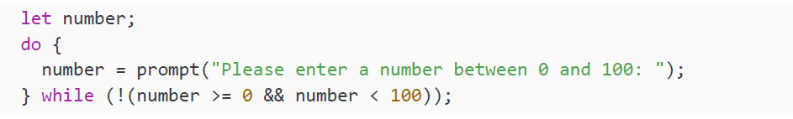
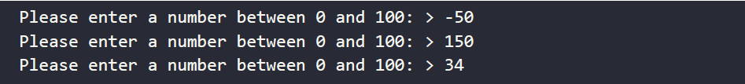
do while loops
We can use the prompt() method to get user input. Let's use a do while loop to ask the user for a number between 0 and 100.
Here is the output; you will have to enter the number in the console yourself here.
It asks three times, because the first two times the number was not between 0 and 100 and the condition in the while block was true. With 34, the condition in the while block became false and the loop ended.

Slide 13
Practice exercise 5.2
In this exercise, we will create a basic counter that will increase a dynamic variable by a consistent step value, up to an upper limit.
Set the starting counter to 0
Create a variable, step, to increase your counter by
Add a do while loop, printing the counter to the console and incrementing it by the step amount each loop
Continue to loop until the counter is equal to 100 or more than 100

Slide 14
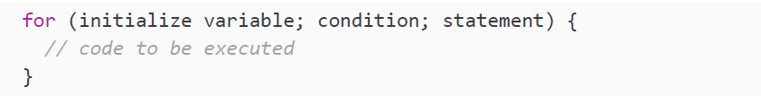
for loops
for loops are special loops. The syntax might be a little bit confusing at first, but you will find yourself using them soon, because they are very useful.
Here is what the syntax looks like:

Slide 15
for loops
Between the parentheses following the for statement, there are three parts, separated by semi-colons. The first one initializes the variables that can be used in the for loop. The second one is a condition: as long as this condition is true, the loop will keep on iterating. This condition gets checked after initializing the variables before the first iteration (this will only take place when the condition evaluates to true). The last one is a statement. This statement gets executed after every iteration. Here is the flow of a for loop:
Initialize the variables.
Check the condition.
If the condition is true, execute the code block. If the condition is false, the loop will end here.
Perform the statement (the third part, for example, i++).
Go back to step 2.

Slide 16
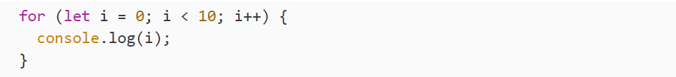
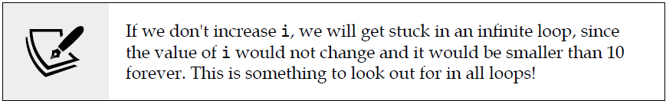
for loops
This is a simple example that logs the numbers 0 to 10 (excluding 10) to the console:
It starts by creating a variable, i, and sets this to 0. Then it checks whether i is smaller than 10. If it is, it will execute the log statement. After this, it will execute i++ and increase i by one.
The condition gets checked again. And this goes on until i reaches a value of 10. 10 is not smaller than 10, so the loop is done executing and the numbers 0 to 9 have been logged to the console.

Slide 17
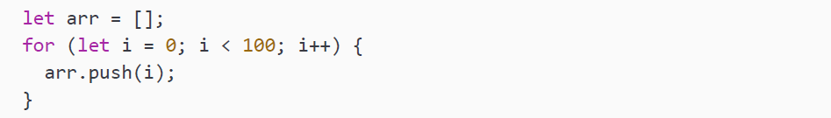
for loops
We can also use a for loop to create a sequence and add values to an array, like this:

Slide 18
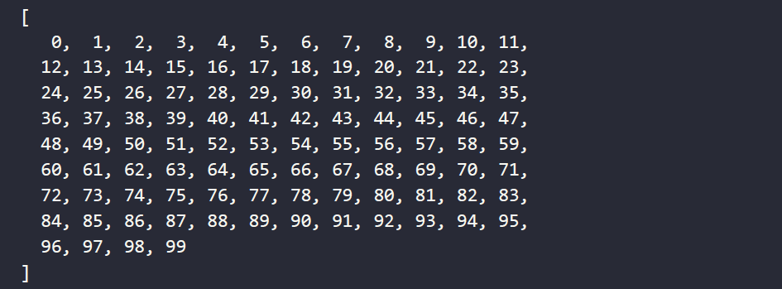
for loops
This is what the array looks like after this loop:
Since the loop ran the block of code 100 times, starting with an initial value of 0 for i, the block of code will add the incrementing value into the array at the end of the array. This results in an array that has a count of 0–99 and a length of 100 items. Since arrays start with an index value of zero, the values in the array will actually match up with the index values of the items in the array.

Slide 19
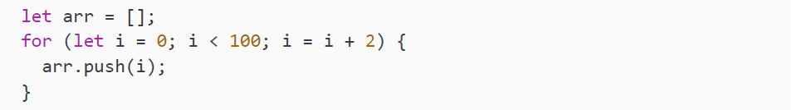
for loops
Or we could create an array containing only even values:

Slide 20
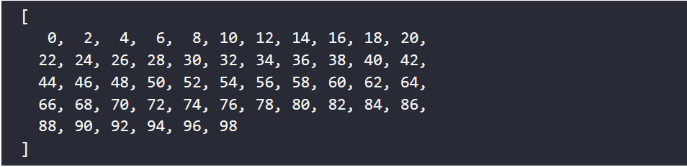
for loops
Resulting in this array:
Most commonly, you will see i++ as the third part of the for loop, but please note that you can write any statement there. In this case, we are using i = i + 2 to add 2 to the previous value every time, creating an array with only even numbers.

Slide 21
Practice exercise 5.3
In this exercise we will use a for loop to create an array that holds objects. Starting with creating a blank array, the block of code within the loop will create an object that gets inserted into the array.
Setup a blank array, myWork.
Using a for loop, create a list of 10 objects, each of which is a numbered lesson (e.g. Lesson 1, Lesson 2, Lesson 3….) with an alternating true/false status for every other item to indicate whether the class will be running this year. For example: name: 'Lesson 1', status: true
You can specify the status by using a ternary operator that checks whether the modulo of the given lesson value is equal to zero and by setting up a Boolean value to alternate the values each iteration.
Create a lesson using a temporary object variable, containing the name (lesson with the numeric value) and predefined status (which we set up in the previous step).
Push the objects to the myWork array.
Output the array to the console.

Slide 22
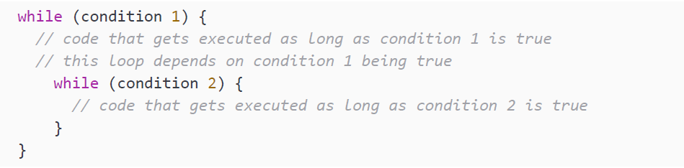
Nested loops
Sometimes it can be necessary to use a loop inside a loop. A loop inside a loop is called a nested loop. Often it is not the best solution to the problem. It could even be a sign of poorly written code (sometimes called "code smell" among programmers), but every now and then it is a perfectly fine solution to a problem.
Here is what it would look like for while loops:
Nesting can also be used with for loops, or with a combination of both for and while, or even with all kinds of loops; they can go several levels deep.

Slide 23
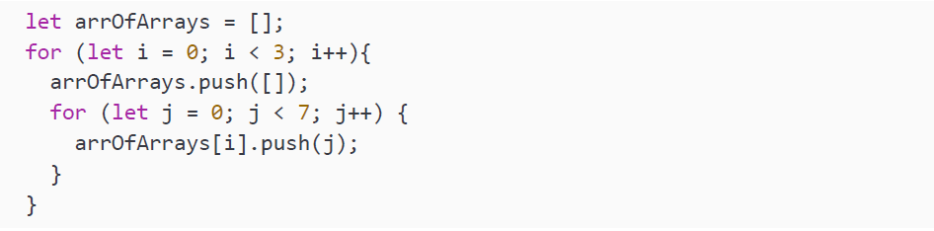
Nested loops
An example in which we might use nested loops would be when we want to create an array of arrays. With the outer loop, we create the top-level array, and with the inner loop we add the values to the array.
When we log this array like this:

Slide 24
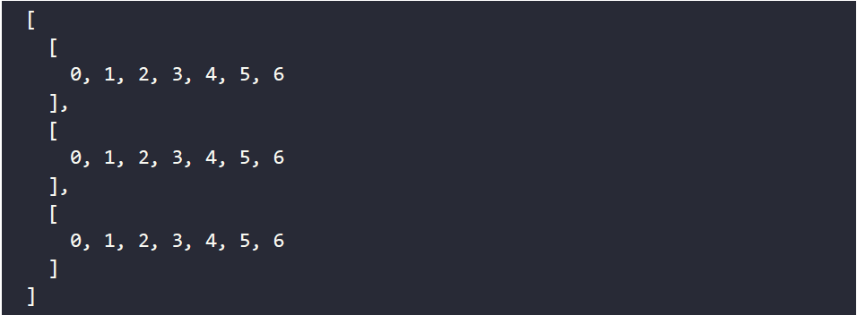
Nested loops
We can see that the output is an array of arrays with values from 0 up to 6.

Slide 25
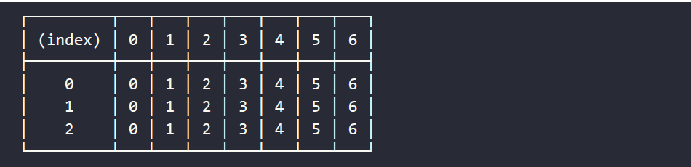
Nested loops
We used the nested loops to create an array in an array, meaning we can work with rows and columns after having created this loop. This means nested loops can be used to create tabular data. We can show this output as a table using the console. table() method instead, like so:
This will output:
Let's put this into practice in the next exercise.

Slide 26
Practice exercise 5.4
In this exercise we will be generating a table of values. We will be using loops to generate rows and also columns, which will be nested within the rows. Nested arrays can be used to represent rows in a table. This is a common structure in spreadsheets, where each row is a nested array within a table and the contents of these rows are the cells in the table. The columns will align as we are creating an equal number of cells in each row.
To create a table generator, first create an empty array, myTable, to hold your table data.
Set variable values for the number of rows and columns. This will allow us to dynamically control how many rows and columns we want within the table. Separating the values from the main code helps make updates to the dimensions easier.
Set up a counter variable with an initial value of 0. The counter will be used to set the content and count the values of the cells within the table.
Create a for loop with conditions to set the number of iterations, and to construct each row of the table. Within it, set up a new temporary array (tempTable) to hold each row of data. The columns will be nested within the rows, generating each cell needed for the column.

Slide 27
Practice exercise 5.4
Nest a second loop within the first to count the columns. Columns are run within the row loop so that we have a uniform number of columns within the table.
Increment the main counter each iteration of the inner loop, so that we track a master count of each one of the cells and how many cells are created.
Push the counter values to the temporary array, tempTable. Since the array is a nested array representing a table, the values of the counter can also be used to illustrate the cell values next to each other in the table. Although these are separate arrays representing new rows, the value of the counter will help illustrate the overall sequence of cells in the final table.
Push the temporary array to the main table. As each iteration builds a new row of array items, this will continue to build the main table in the array.
Output into the console with console.table(myTable). This will show you a visual representation of the table structure.

Slide 28
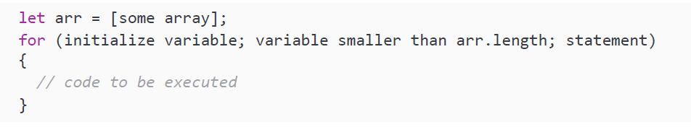
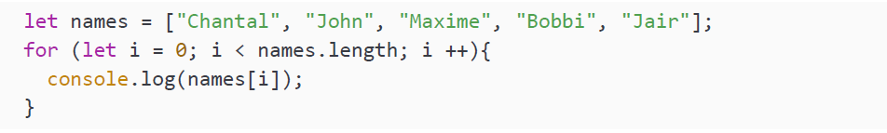
Loops and arrays
If you are not convinced of how extremely useful loops are by now, have a look at loops and arrays. Loops make life with arrays a lot more comfortable.
We can combine the length property and the condition part of the for loop or while loop to loop over arrays. It would look like this in the case of a for loop:
Let's start with a simple example that is going to log every value of the array:

Slide 29
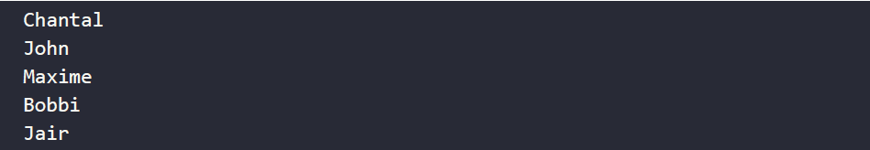
Loops and arrays
This will output:
We use the length property to determine the maximum value of our index. The index starts counting at 0, but the length does not. The index is always one smaller than the length. Hence, we loop over the values of the array by increasing the length.

Slide 30
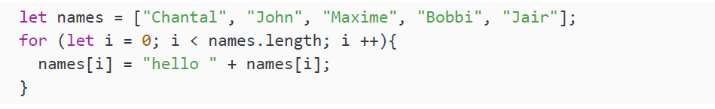
Loops and arrays
In this case we aren't doing very interesting things yet; we are simply printing the values. But we could be changing the values of the array in a loop, for example, like this:

Slide 31
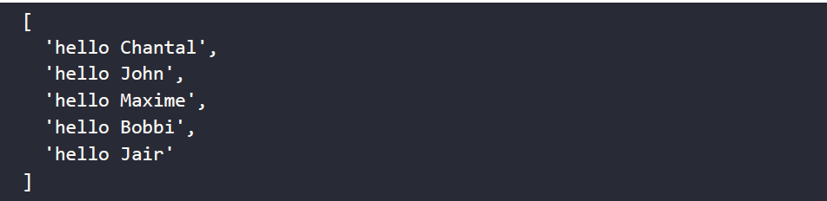
Loops and arrays
We have concatenated hello with the beginnings of our names. The array is changed in the loop and the array will have this content after the loop has executed:

Slide 32
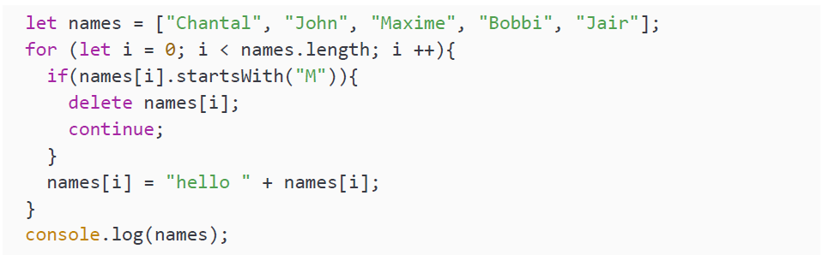
Loops and arrays
The possibilities are endless here. When an array comes in somewhere in the application, data can be sent to the database per value. Data can be modified by value, or even filtered, like this:
The startsWith() method just checks whether the string starts with a certain character. In this case it checks whether the name starts with the string M.

Slide 33
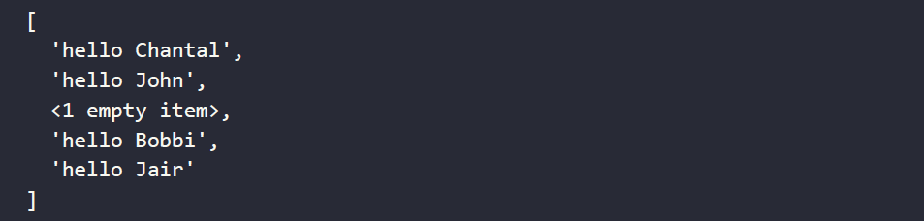
Loops and arrays
The output is:
You'll have to be careful here though. If we were to remove the item instead of deleting it and leaving an empty value, we would accidentally skip the next value, since that value gets the index of the recently deleted one and i is incremented and moves on to the next index.

Slide 34
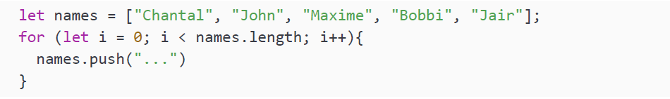
Loops and arrays
What do you think this one does:
Your program gets stuck in an infinite loop here. Since a value gets added every iteration, the length of the loop grows with every iteration and i will never be bigger than or equal to length.

Slide 35
Practice exercise 5.5
Explore how to create a table grid that contains nested arrays as rows within a table. The rows will each contain the number of cells needed for the number of columns set in the variables. This grid table will dynamically adjust depending on the values for the variables.
Create a grid array variable.
Set a value of 64 for the number of cells.
Set a counter to 0.
Create a global variable to be used for the row array.
Create a loop that will iterate up to the number of cells you want in the array, plus one to include the zero value. In our example, we would use 64+1.
Add an outer if statement, which uses modulo to check if the main counter is divisible by 8 or whatever number of columns you want.
Inside the preceding if statement, add another if statement to check if the row is undefined, indicating whether it is the first run or whether the row is complete. If the row has been defined, then add the row to the main grid array.

Slide 36
Practice exercise 5.5
To finish off the outer if statement, if the counter is divisible by 8, clear the row array—it has already been added to the grid by the inner if statement.
At the end of the for loop, increment of the main counter by 1.
Set up a temporary variable to hold the value of the counter and push it to the row array.
Within the loop iteration, check if the value of the counter is equal to the total number of columns you want; if it is, then add the current row to the grid.
Please note that the extra cell will not be added to the grid since there aren’t enough cells to make a new row within the condition that adds the rows to the grid. An alternative solution would be to remove the +1 from the loop condition and add grid.push(row) after the loop is completed, both of which will provide the same solution output.
Output the grid into the console.

Slide 37
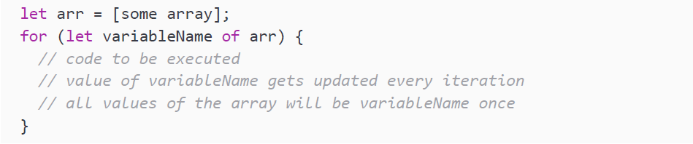
for of loop
There is another loop we can use to iterate over the elements of an array: the for of loop. It cannot be used to change the value associated with the index as we can do with the regular loop, but for processing values it is a very nice and readable loop.
Here is what the syntax looks like:

Slide 38
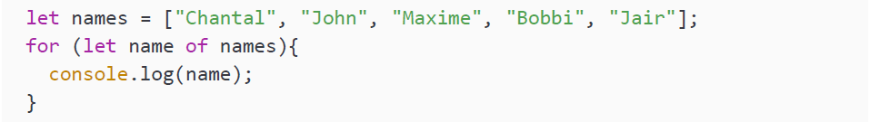
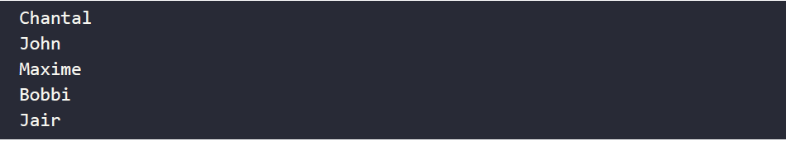
for of loop
So you can read it like this: "For every value of the array, call it variableName and do the following." We can log our names array using this loop:
We need to specify a temporary variable; in this case we called it name. This is used to put the value of the current iteration in, and after the iteration, it gets replaced with the next value. This code results in the following output:
There are some limitations here; we cannot modify the array, but we could write all the elements to a database or a file, or send it somewhere else. The advantage of this is that we cannot accidentally get stuck in an infinite loop or skip values.

Slide 39
Practice exercise 5.6
This exercise will construct an array as it loops through the incrementing values of x. Once the array is done, this exercise also will demonstrate several ways to output array contents.
Create an empty array
Run a loop 10 times, adding a new incrementing value to the array
Log the array into the console
Use the for loop to iterate through the array (adjust the number of iterations to however many values are in your array) and output into the console
Use the for of loop to output the value into the console from the array

Slide 40
Loops and objects
We have just seen how to loop over the values of an array, but we can also loop
over the properties of an object. This can be helpful when we need to go over all the
properties but don't know the exact properties of the object we are iterating over.
Looping over an object can be done in a few ways. We can use the for in loop to
loop over the object directly, or we can convert the object to an array and loop over
the array. We'll consider both in the following sections.

Slide 41
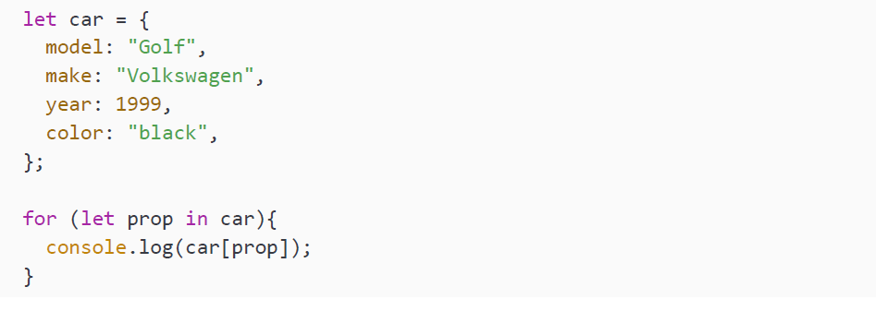
for in loop
Manipulating objects with loops can also be done with another variation of the for loop, the for in loop. The for in loop is somewhat similar to the for of loop. Again here, we need to specify a temporary name, also referred to as a key, to store each property name in. We can see it in action here:

Slide 42
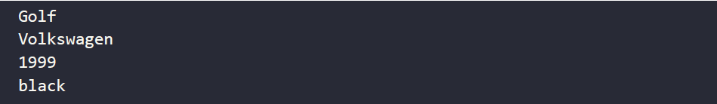
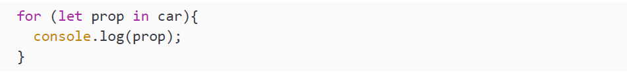
for in loop
We need to use the prop of each loop iteration to get the value out of the car object. The output then becomes:
If we just logged the prop, like this:

Slide 43
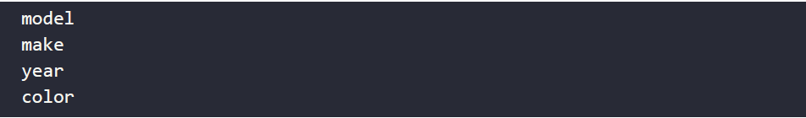
for in loop
This is what our output would look like:
As you can see, all the names of the properties get printed, and not the values. This is because the for in loop is getting the property names (keys) and not the values. The for of is doing the opposite; it is getting the values and not the keys. This for in loop can also be used on arrays, but it is not really useful. It will only return the indices, since these are the "keys" of the values of the arrays. Also, it should be noted that the order of execution cannot be guaranteed, even though this is usually important for arrays. It is therefore better to use the approaches mentioned in the section on loops and arrays.

Slide 44
Practice exercise 5.7
In this exercise, we will experiment with looping over objects and internal arrays.
Create a simple object with three items in it.
Using the for in loop, get the properties' names and values from the object and output them into the console.
Create an array containing the same three items. Using either the for loop or the for in loop, output the values from the array into the console.

Slide 45
Looping over objects by converting to an array
You can use any loop on objects, as soon as you convert the object to an array. This can be done in three ways:
Convert the keys of the object to an array
Convert the values of the object to an array
Convert the key-value entries to an array (containing arrays with two elements: object key and object value)

Slide 46
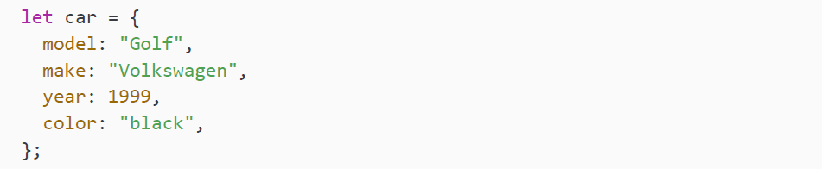
Looping over objects by converting to an array
Let's use this example:
If we want to loop over the keys of the object, we can use the for in loop, as we saw in the previous section, but we can also use the for of loop if we convert it to an array first. We do so by using the Object.keys(nameOfObject) built-in function. This takes an object and grabs all the properties of this object and converts them to an array.

Slide 47
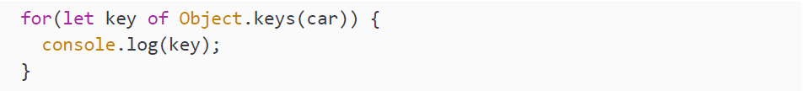
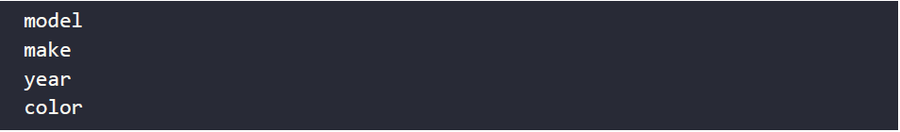
Looping over objects by converting to an array
To demonstrate how this works:
This will output:
We can loop over the properties of this array like this using the for of loop:
And this is what it will output:

Slide 48
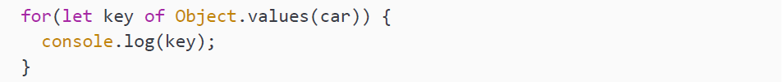
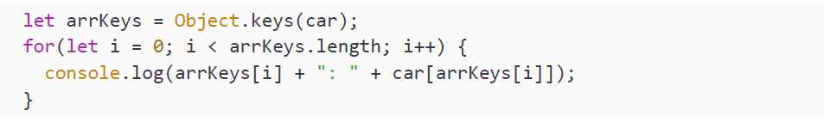
Looping over objects by converting to an array
Similarly, we can use the for of loop to loop over the values of the object by converting the values to an array. The main difference here is that we use Object. values(nameOfObject):
You can loop over these arrays in the same way you loop over any array. You can use the length and index strategy like this in a regular for loop:

Slide 49
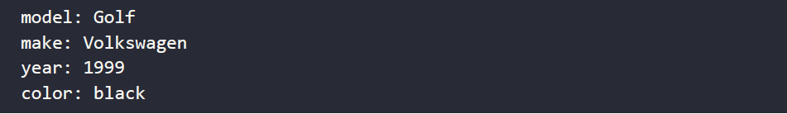
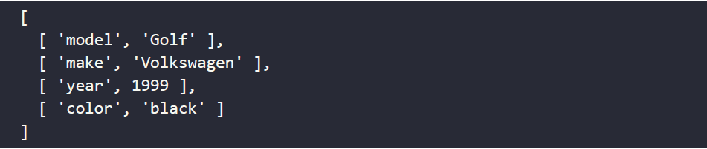
Looping over objects by converting to an array
And this will output:
More interesting is how to loop over both arrays at the same time using the for of loop. In order to do so, we will have to use Object.entries(). Let's demonstrate what it does: This will output:

Slide 50
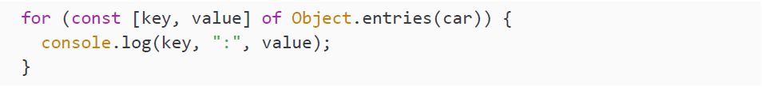
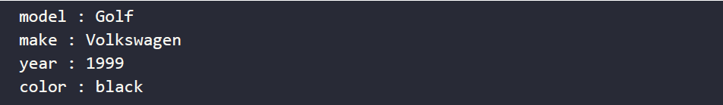
Looping over objects by converting to an array
As you can see, it is returning a two-dimensional array, containing key-value pairs. We can loop over it like this:
And this will output:
Alright, you have seen many ways to loop over objects now. Most of them come down to converting the object to an array. We can imagine that at this point you could use a break. Or maybe you'd just like to continue?

Slide 51
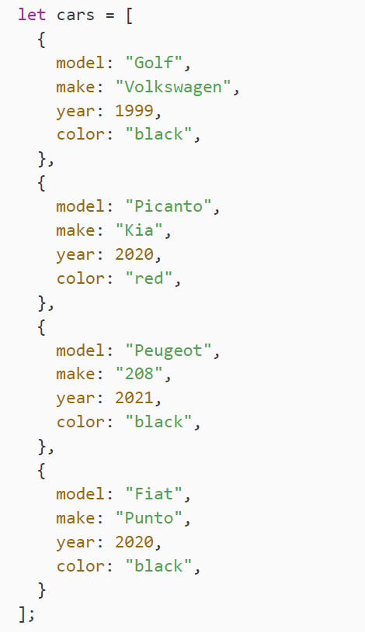
break and continue
break and continue are two keywords that we can use to control the flow of execution of the loop. break will stop the loop and move on to the code below the loop. continue will stop the current iteration and move back to the top of the loop, checking the condition (or in the case of a for loop, performing the statement and then checking the condition).
We will be using this array of car objects to demonstrate break and continue:
We will first have a closer look at break.

Slide 52
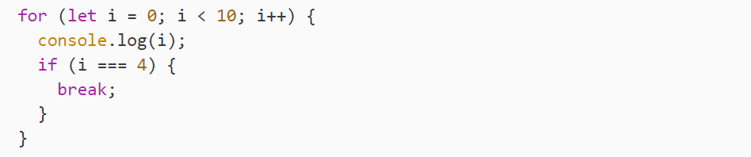
break
We have already seen break in the switch statement. When break was executed, the switch statement ended. This is not very different when it comes to loops: when the break statement is executed, the loop will end, even when the condition is still true.
Here is a silly example to demonstrate how break works:
It looks like a loop that will log the numbers 0 to 10 (again excluding 10) to the console. There is a catch here though: as soon as i equals 4, we execute the break command. break ends the loop immediately, so no more loop code gets executed afterward.

Slide 53
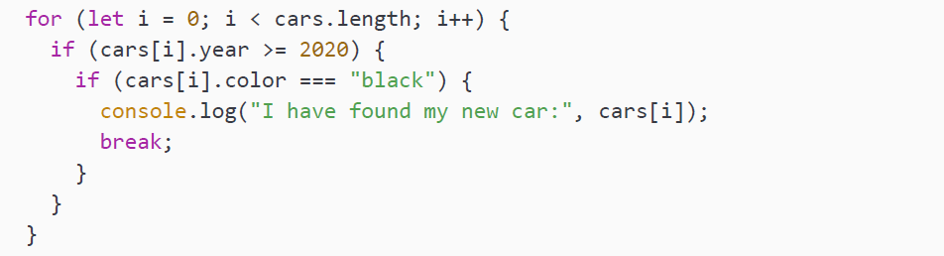
break
We can also use break to stop looping through the array of cars when we have found a car that matches our demands.

Slide 54
break
As soon as we run into a car with the year 2020 or later and the car is black, we will stop looking for other cars and just buy that one. The last car in the array would also have been an option, but we did not even consider it because we found one already. The code snippet will output this:
However, often it is not a best practice to use break. If you can manage to work with the condition of the loop to break out of the loop instead, this is a much better practice. It prevents you getting stuck in an infinite loop, and the code is easier to read.

Slide 55
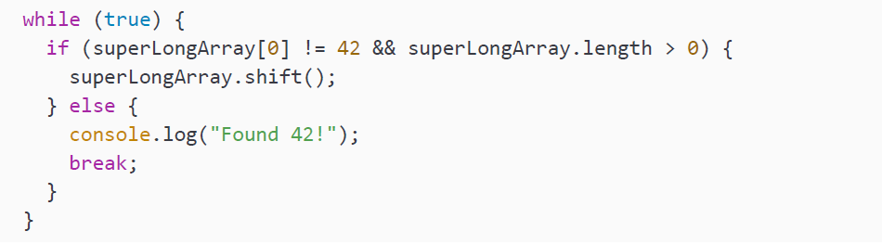
break
If the condition of the loop is not an actual condition, but pretty much a run-forever kind of statement, the code gets hard to read.
Consider the following code snippet:

Slide 56
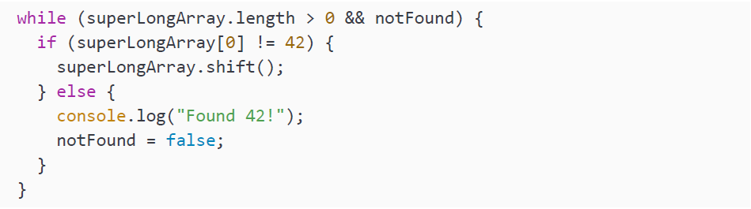
break
This would be better to write without break and without something terrible like while(true); you could do it like this:
With the second example, we can see the conditions of the loop easily, namely the length of the array and a notFound flag. However, with while(true) we are kind of misusing the while concept. You want to specify the condition, and it should evaluate to true or false; this way your code is nice to read. If you say while(true), you're actually saying forever, and the reader of your code will have to interpret it line by line to see what is going on and when the loop is ended by a workaround break statement.

Slide 57
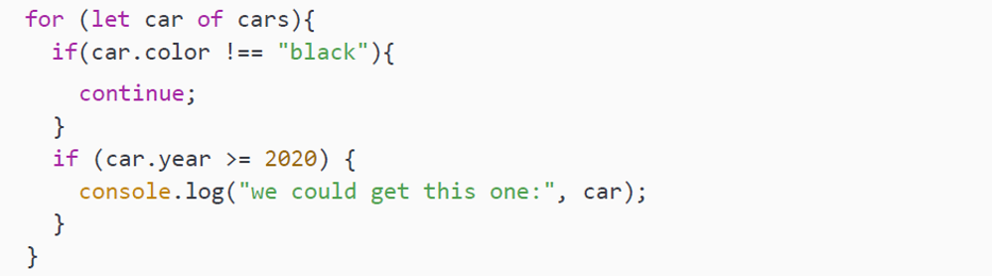
continue
break can be used to quit the loop, and continue can be used to move on to the next iteration of the loop. It quits the current iteration and moves back up to check the condition and start a new iteration.
Here you can see an example of continue:

Slide 58


continue
The approach here is to just skip every car that is not black and consider all the others that are not older than make year 2020 or later. The code will output this:
Be careful with continue in a while loop. Without running it, what do you think the next code snippet does?

Slide 59

continue
It logs 1, and then it gets you stuck in an infinite loop, because continue gets hit before the value of i changes, so it will run into continue again, and again, and so on. This can be fixed by moving the i++ up and subtracting 1 from i, like this:

Slide 60

continue
But again, there is a better way without continue here. The chance of error is a lot smaller:
And as you can see it is even shorter and more readable. The value of break and continue usually comes in when you are looping over large data sets, possibly coming from outside your application. Here you'll have less influence to apply other types of control. Using break and continue is not a best practice for simple basic examples, but it's a great way to get familiar with the concepts.

Slide 61
Practice exercise 5.8
This exercise will demonstrate how to create a string with all the digits as it loops through them. We can also set a value to skip by adding a condition that will use continue, skipping the matching condition. A second option is to do the same exercise and use the break keyword.
Set up a string variable to use as output.
Select a number to skip, and set that number as a variable.
Create a for loop that counts to 10.
Add a condition to check if the value of the looped variable is equal to the number that should be skipped.
If the number is to be skipped in the condition, continue to the next number.
As you iterate through the values, append the new count value to the end of the main output variable.
Output the main variable after the loop completes.
Reuse the code, but change the continue to break and see the difference. It should now stop at the skip value.

Slide 62

break, continue, and nested loops
break and continue can be used in nested loops as well, but it is important to know that when break or continue is used in a nested loop, the outer loop will not break.
We will use this array of arrays to discuss break and continue in nested loops:

Slide 63

break, continue, and nested loops
Let's break down this example. We are looking for all the groups that have two names starting with an M. If we find such a group, we will log it.

Slide 64

break, continue, and nested loops
We first loop over the top-level arrays and set a counter, matches, with a start value of 0, and for each of these top-level arrays, we are going to loop over the values. When a value starts with an M, we increase matches by one and check whether we have found two matches already. If we find two Ms, we break out of the inner loop and continue in our outer loop. This one will move on to the next top-level array, since nothing is happening after the inner loop.
If the name does not start with an M, we do not need to check for matches being 2, and we can continue to the next value in the inner array.
Take a look at this example: what do you think it will log?

Slide 65
break, continue, and nested loops
It will loop over the arrays, and for every array it will check the value to see if it starts with an M. If it does, the inner loop will break. So, if one of the arrays in the array contains multiple values starting with M, only the first one will be found, since the iteration over that array breaks and we continue to the next array.
This one will output:
We can see that it finds Margot, the first one from the second array, but it skips Marina, because it is the second one in the array. And it breaks after having found one group, so it won't loop over the other elements in the inner array. It will continue with the next array, which doesn't contain names starting with an M.

Slide 66
break, continue, and nested loops
If we wanted to find groups that have a member with a name that starts with an M, the previous code snippet would have been the way to go, because we are breaking the inner loop as soon as we find a hit. This can be useful whenever you want to make sure that an array in a data set contains at least one of something. Because of the nature of the for of loop, it won't give the index or place where it found it. It will simply break, and you have the value of the element of the array to use. If you need to know more, you can work with counters, which are updated every iteration.
If we want to see whether only one of all the names in the array of arrays starts with an M, we would have to break out of the outer loop. This is something we can do with labeled loops.

Slide 67

break and continue and labeled blocks
We can break out of the outer loop from inside the inner loop, but only if we give a label to our loop. This can be done like this:

Slide 68
break and continue and labeled blocks
We are giving our block a label by putting a word and a colon in front of a code block. These words can be pretty much anything (in our case, "outer" and "inner"), but not JavaScript's own reserved words, such as for, if, break, else, and others.
This will only log the first name starting with an M:
It will only log one, because it is breaking out of the outer loop and all the loops end as soon as they find one. In a similar fashion you can continue the outer loop as well.
Whenever you want to be done as soon as you find one hit, this is the option to use. So, for example, if you want check for errors and quit if there aren't any, this would be the way to go.

Slide 69
Math multiplication table
In this project, you will create a math multiplication table using loops. You can do this using your own creativity or by following some of the following suggested steps:
Set up a blank array to contain the final multiplication table.
Set a value variable to specify how many values you want to multiply with one another and show the results for.
Create an outer for loop to iterate through each row and a temp array to store the row values. Each row will be an array of cells that will be nested into the final table.
Add an inner for loop for the column values, which will push the multiplied row and column values to the temp array.
Add the temporary row data that contains the calculated solutions to the main array of the final table. The final result will add a row of values for the calculations.

Slide 70

Self-check quiz
What is the expected output for the following code?

Slide 71

Self-check quiz
What is the final value for myArray, and what is expected in the console?

Slide 72
Summary
In this chapter we introduced the concept of loops. Loops enable us to repeat a certain block of code. We need some sort of condition when we loop, and as long as that condition is true, we'll keep looping. As soon as it changes to false, we end our loop.
We have seen the while loop, in which we just insert a condition, and as long as that condition is true we keep looping. If the condition is never true, we won't even execute the loop code once.
This is different for the do while loop. We always execute the code once, and then we start to check a condition. If this condition is true, we execute the code again and do so until the condition becomes false. This can be useful when working with input from outside, such as user input. We would need to request it once, and then we can keep on requesting it again until it is valid.

Slide 73
Summary
Then we saw the for loop, which has a slightly different syntax. We have to specify a variable, check a condition (preferably using that variable, but this is not mandatory), and then specify an action to be executed after every iteration. Again, it's preferable for the action to include the variable from the first part of the for loop. This gives us code that is to be executed as long as a condition is true.
We also saw two ways to loop over arrays and objects, for in and for of. The for in loop loops over keys and for of loops over values. They go over every element in a collection. The advantage of these loops is that JavaScript controls the execution: you can't miss an element or get stuck in an infinite loop.
Lastly, we saw break and continue. We can use the break keyword to end a loop immediately and the continue keyword to end the current iteration and go back to the top and start the next iteration, if the condition is still true, that is.
In the next chapter we are going to be adding a really powerful tool to our JavaScript toolbox: functions! They allow us to take our coding skills to the next level and structure our code better.

